Slide 1



CAPSTONE PROJECT ON
Stellar Object classification
KHYATHI KOTIAN

Slide 2



OBJECTIVE
DATA HANDLING
AGENDA
ANALYSIS
MODELLING
DEPLOYMENT
CONFIDENTIAL: The information in this document belongs to Boston Institute of Analytics LLC. Any unauthorized sharing of this material is prohibited and subject to legal action under breach of IP and confidentiality clauses.

Slide 3


OBJECTIVE
Objective: Develop machine learning models to classify celestial objects, including stars, galaxies, and quasars, using spectral data
Methods: Leverage advanced machine learning techniques to analyze distinguishing features, optimize large-scale data processing, and ensure efficient and accurate automated classification
Analysis: Perform comparative evaluations of different ML algorithms to identify the most effective approaches for improving classification accuracy and scalability
CONFIDENTIAL: The information in this document belongs to Boston Institute of Analytics LLC. Any unauthorized sharing of this material is prohibited and subject to legal action under breach of IP and confidentiality clauses.

Slide 4


What is the Machine learning Problem that we are dealing with?
Basis the target feature as “Class”. We are dealing with a multi class classification problem

Slide 5

DECISION TREE
RANDOM FOREST
K-NEAREST NEIGHBORS (KNN)
MODELS USED
SUPPORT VECTOR MACHINES (SVM)
GRADIENT BOOSTING
ADA BOOST
XG BOOST
CONFIDENTIAL: The information in this document belongs to Boston Institute of Analytics LLC. Any unauthorized sharing of this material is prohibited and subject to legal action under breach of IP and confidentiality clauses.

Slide 6
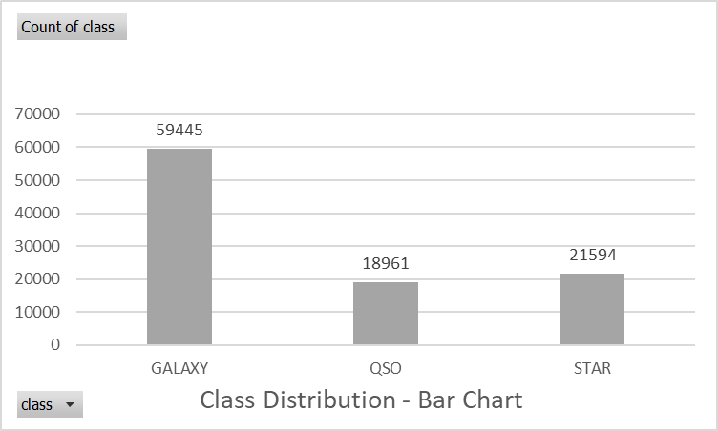
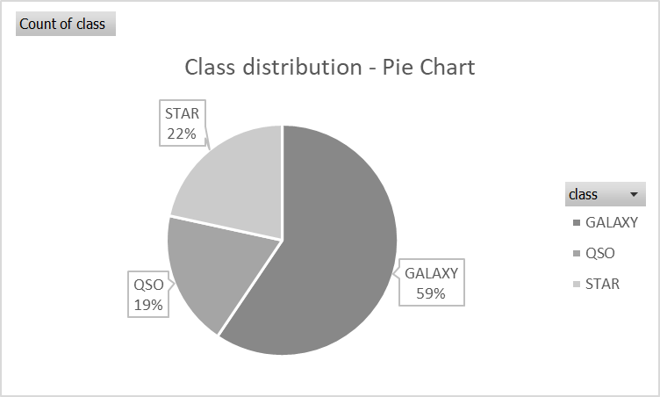
TARGET VARIABLE
We are dealing with an imbalanced dataset

Slide 7
FOR CLASSIFICATION, WE USED METRICS LIKE
•ACCURACY
•RECALL
•PRECISION
•F1 SCORE
•CONFUSION MATRICS AND
•CLASSIFICATION REPORT
EVALUATION METRICS
CONFIDENTIAL: The information in this document belongs to Boston Institute of Analytics LLC. Any unauthorized sharing of this material is prohibited and subject to legal action under breach of IP and confidentiality clauses.

Slide 8
•Understanding the data
•Handling the Missing Values
•Outlier Analysis
•Univariate Analysis
•Bivariate Analysis
•Standardizing all values to one scale(min-max Scaler)
•Label Encoding
EXPLORATORY
DATA ANALYSIS (EDA)
CONFIDENTIAL: The information in this document belongs to Boston Institute of Analytics LLC. Any unauthorized sharing of this material is prohibited and subject to legal action under breach of IP and confidentiality clauses.

Slide 9

DATASET AND UNDERSTANDING
Source: SDSS from Kaggle
Data Shape (1,00,000, 18)
17 Numerical Data -obj_ID, alpha, delta, u, g, r, i, z (spectral data magnitudes), run_ID, rerun_ID,cam_col, field_ID, spec_obj_ID, redshift (important for quasars), plate, MJD, fiber_ID
1 Categorical Data -Indicates object type (Star, Galaxy and Quasar)
Significantly useful features in the dataset - Navigation, ascencion and declination and filters of the
photometric system - u,g,r,i,z and redshift
CONFIDENTIAL: The information in this document belongs to Boston Institute of Analytics LLC. Any unauthorized sharing of this material is prohibited and subject to legal action under breach of IP and confidentiality clauses.

Slide 10
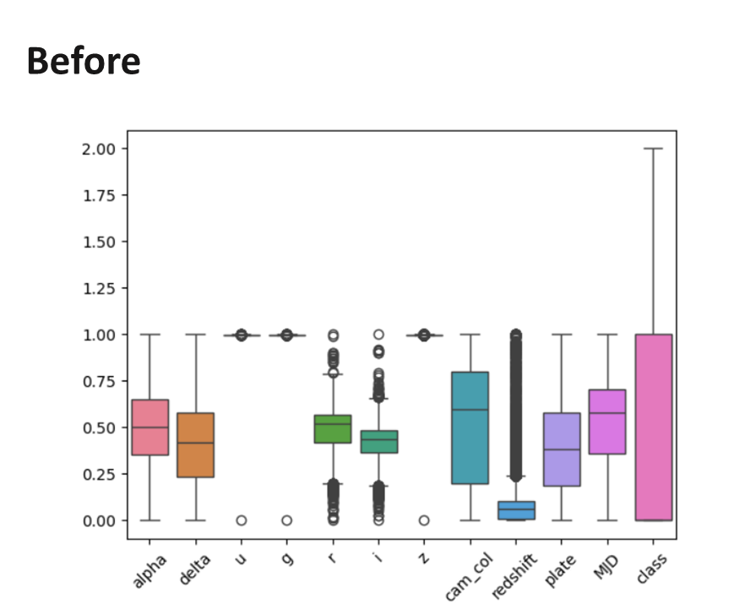
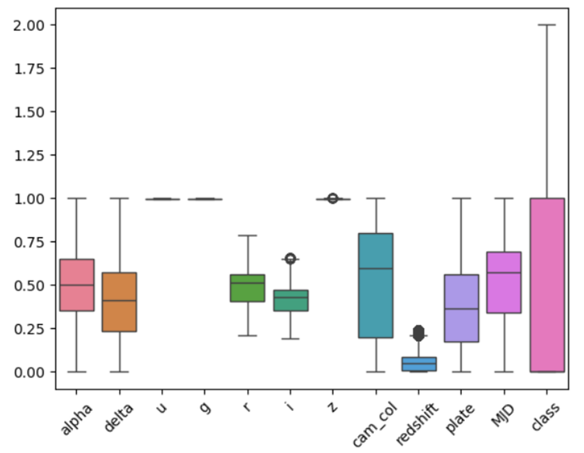
OUTLIER ANALYSIS
PERCENTAGE OF OUTLIERS REMOVED FROM THE DATA SET IS 9.4%
Before
After

Slide 11
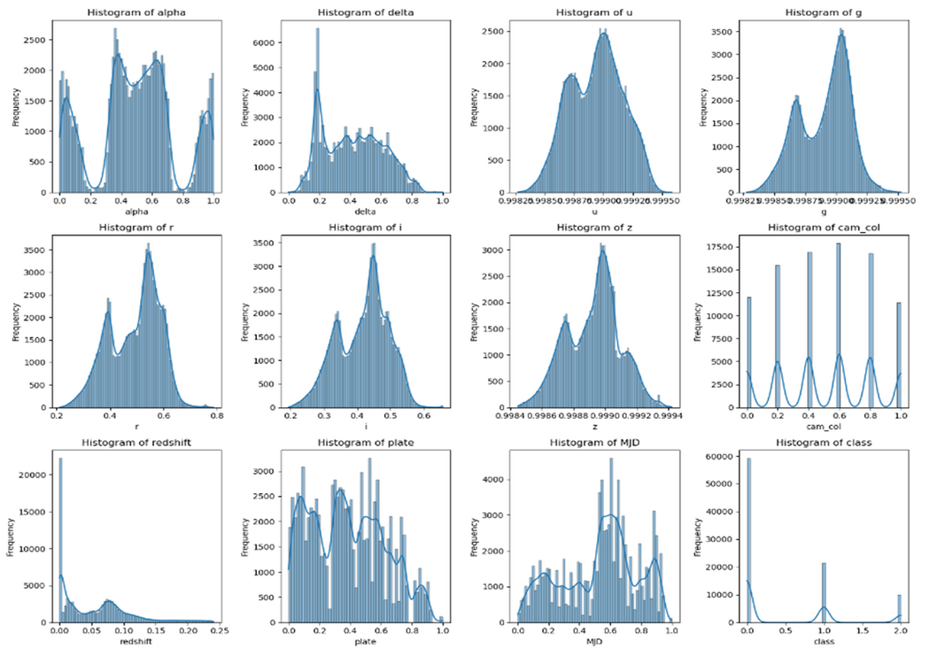
UNIVARIATE ANALYSIS
CONFIDENTIAL: The information in this document belongs to Boston Institute of Analytics LLC. Any unauthorized sharing of this material is prohibited and subject to legal action under breach of IP and confidentiality clauses.

Slide 12
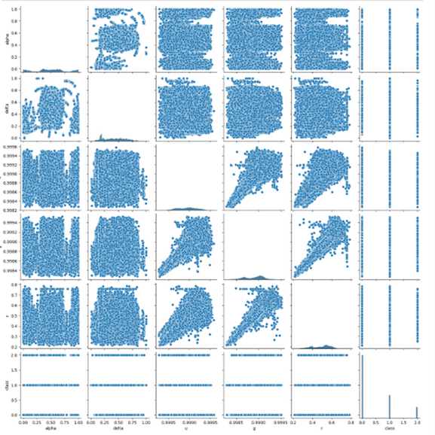
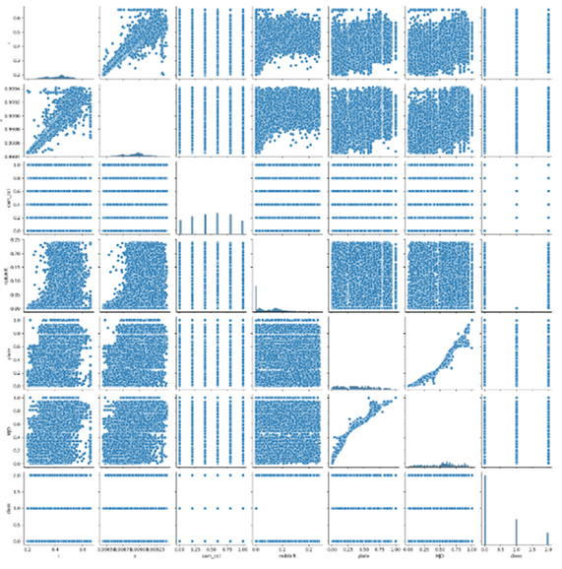
BIVARIATE ANALYSIS
CONFIDENTIAL: The information in this document belongs to Boston Institute of Analytics LLC. Any unauthorized sharing of this material is prohibited and subject to legal action under breach of IP and confidentiality clauses.

Slide 13
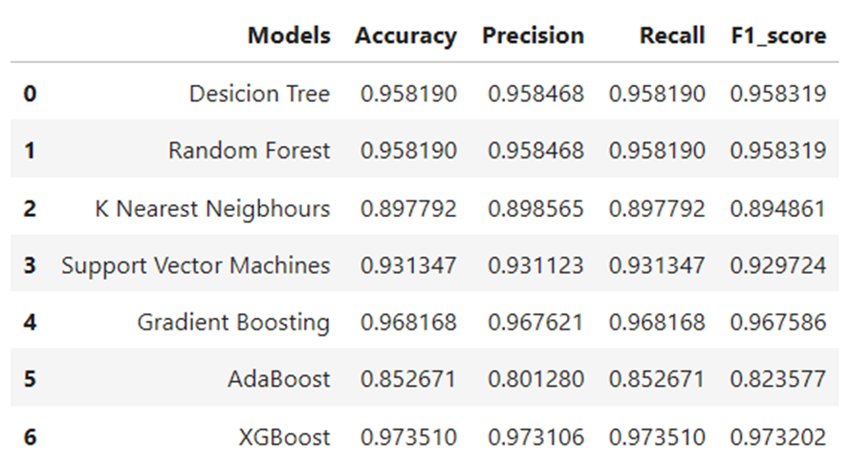
MODEL TRAINING AND EVALUATION
CONFIDENTIAL: The information in this document belongs to Boston Institute of Analytics LLC. Any unauthorized sharing of this material is prohibited and subject to legal action under breach of IP and confidentiality clauses.

Slide 14
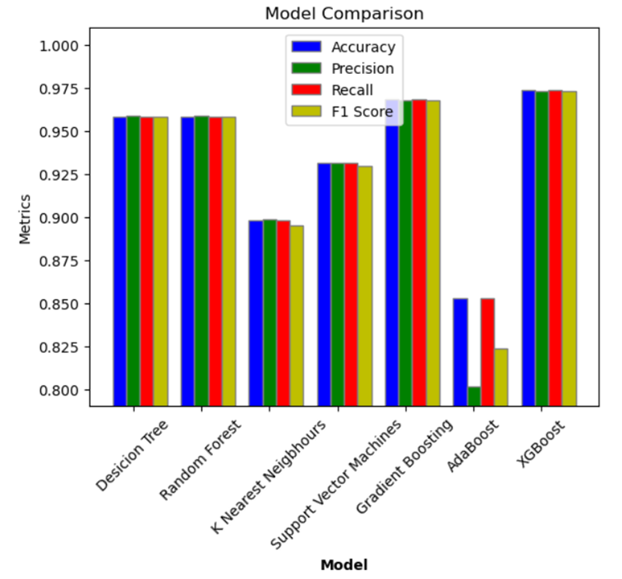
COMPARING
MODEL
PERFORMANCE
CONFIDENTIAL: The information in this document belongs to Boston Institute of Analytics LLC. Any unauthorized sharing of this material is prohibited and subject to legal action under breach of IP and confidentiality clauses.

Slide 15
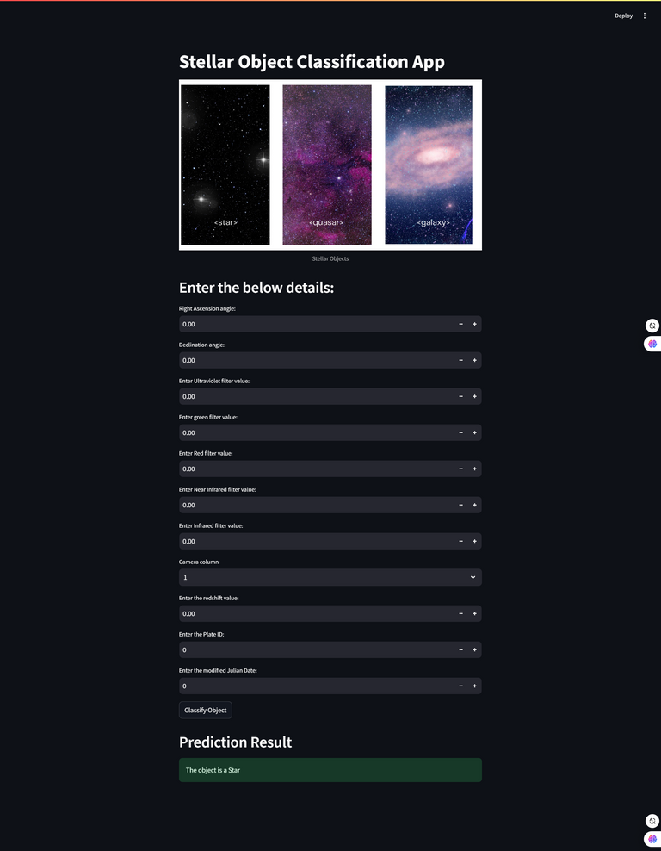
DEPLOYMENT WITH
STREAMLIT
CONFIDENTIAL: The information in this document belongs to Boston Institute of Analytics LLC. Any unauthorized sharing of this material is prohibited and subject to legal action under breach of IP and confidentiality clauses.

Slide 16
GIT HUB REPOSITORY
CONFIDENTIAL: The information in this document belongs to Boston Institute of Analytics LLC. Any unauthorized sharing of this material is prohibited and subject to legal action under breach of IP and confidentiality clauses.

Slide 17
QUESTIONS?
CONFIDENTIAL: The information in this document belongs to Boston Institute of Analytics LLC. Any unauthorized sharing of this material is prohibited and subject to legal action under breach of IP and confidentiality clauses.

Slide 18
THANK YOU!
CONFIDENTIAL: The information in this document belongs to Boston Institute of Analytics LLC. Any unauthorized sharing of this material is prohibited and subject to legal action under breach of IP and confidentiality clauses.

